Slide 1
The OSI Model and the TCP/IP Protocol Suite
By
Prakash G Asnani
Assistant Professor Computer Science
Government Science College Chikhli

Slide 2
Protocol Layers
protocol is required when two entities need to communicate. When communication is not simple, we may divide the complex task of communication into several layers. In this case, we may need several protocols, one for each layer.
Established in 1947, the International Standards Organization (ISO) is a multinational body dedicated to worldwide agreement on international standards. Almost three-fourths of countries in the world are represented in the ISO. An ISO standard that covers all aspects of network communications is the Open Systems Interconnection (OSI) model. It was first introduced in the late 1970s.

Slide 3
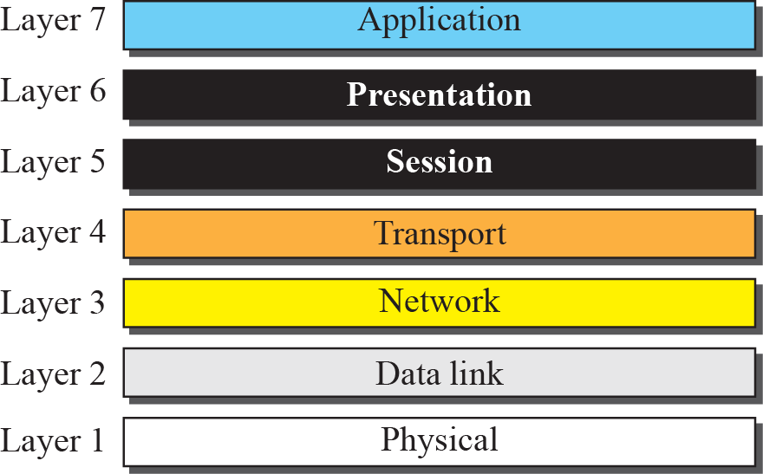
The OSI Model

Slide 4
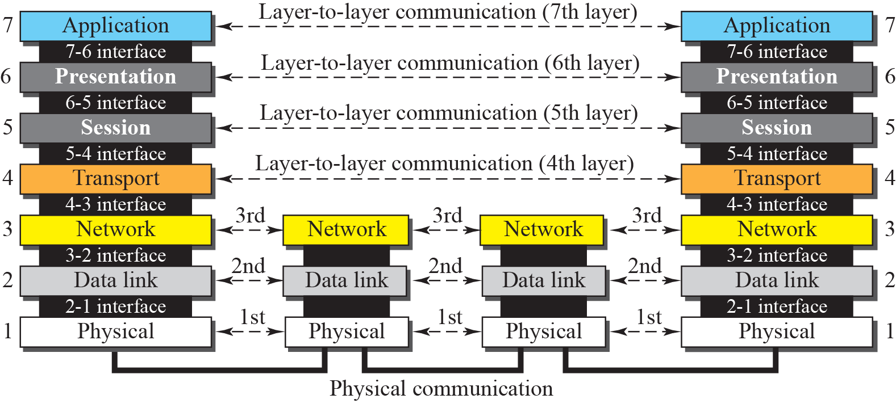
The OSI Layers

Slide 5
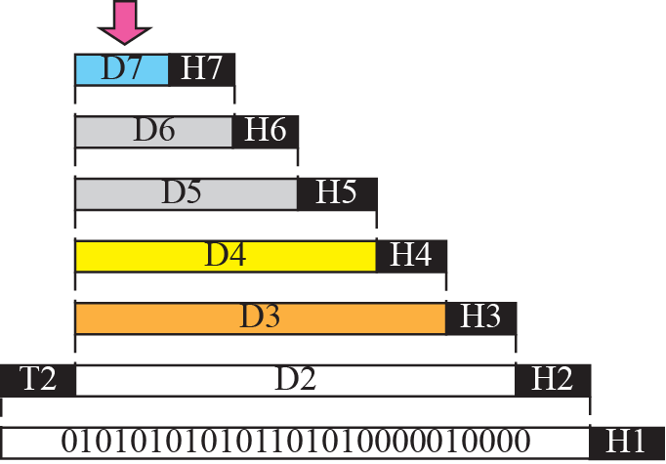
An exchange using the OSI model

Slide 6
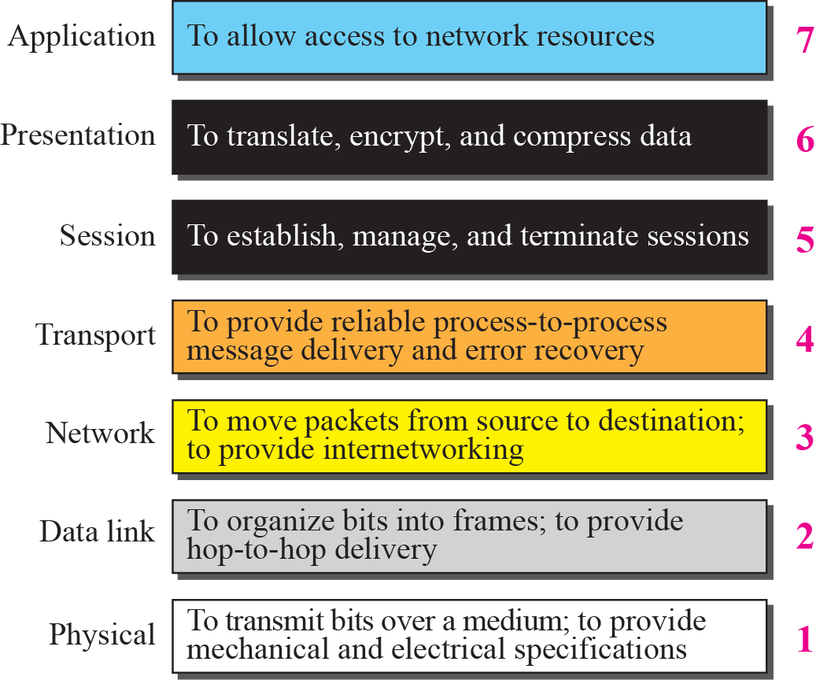
Function of each layer in OSI model

Slide 7
TCP / IP Protocol Suite
The TCP/IP protocol suite was developed prior to the OSI model. Therefore, the layers in the TCP/IP protocol suite do not match exactly with those in the OSI model. The original TCP/IP protocol suite was defined as four software layers built upon the hardware. Today, however, TCP/IP is thought of as a five-layer model with the layers named similarly to the ones in the OSI model. Figure 2.7 shows both configurations.

Slide 8
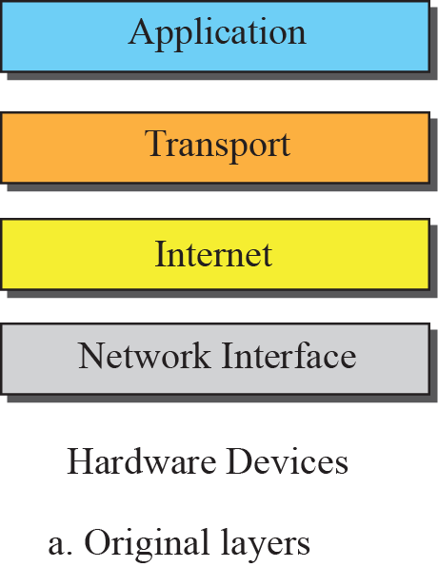
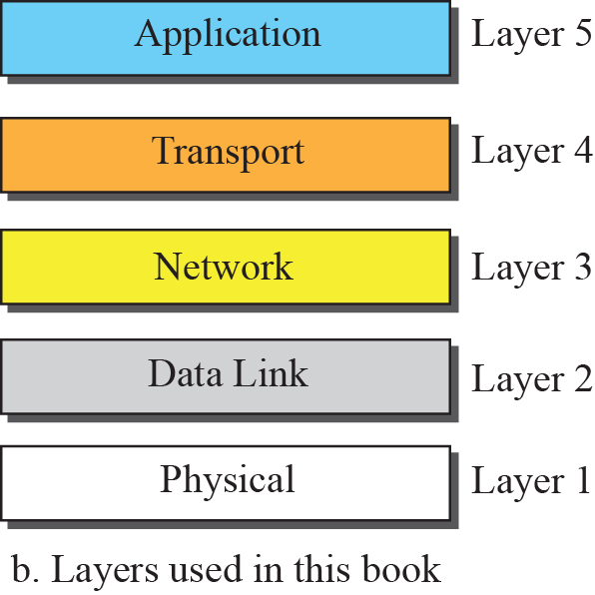
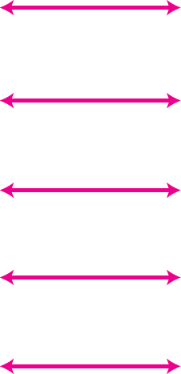
Layers in the TCP/IP Protocol Suite

Slide 9
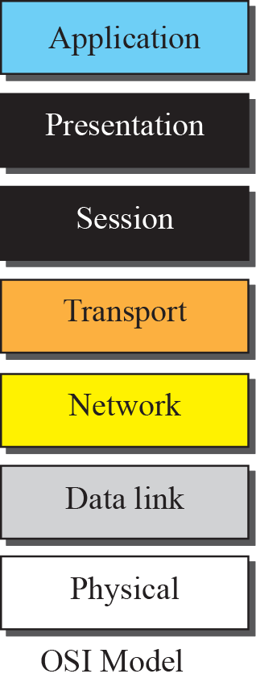
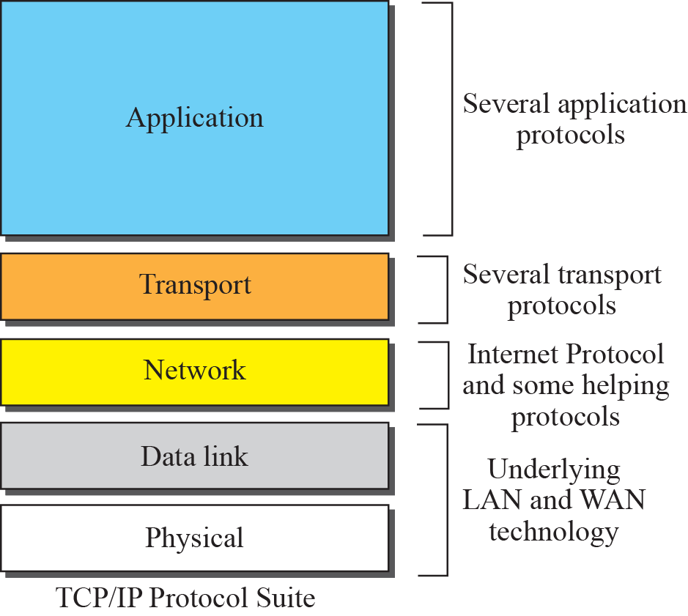
TCP /IP and OSI Model

Slide 10
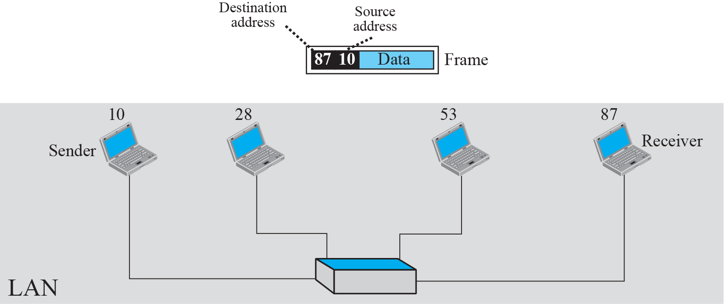
Example 2.3: physical addresses

Slide 11
As we will see in Chapter 3, most local area networks use a 48-bit (6-byte) physical address written as 12 hexadecimal digits; every byte (2 hexadecimal digits) is separated by a colon, as shown below:
07:01:02:01:2C:4B
A 6-byte (12 hexadecimal digits) physical address

Slide 12
Figure 2.17 shows a part of an internet with two routers connecting three LANs. Each device (computer or router) has a pair of addresses (logical and physical) for each connection. In this case, each computer is connected to only one link and therefore has only one pair of addresses. Each router, however, is connected to three networks. So each router has three pairs of addresses, one for each connection. Although it may be obvious that each router must have a separate physical address for each connection, it may not be obvious why it needs a logical address for each connection. We discuss these issues in Chapters 11 and 12 when we discuss routing. The computer with logical address A and physical address 10 needs to send a packet to the computer with logical address P and physical address 95. We use letters to show the logical addresses and numbers for physical addresses, but note that both are actually numbers, as we will see in later chapters.

Slide 13
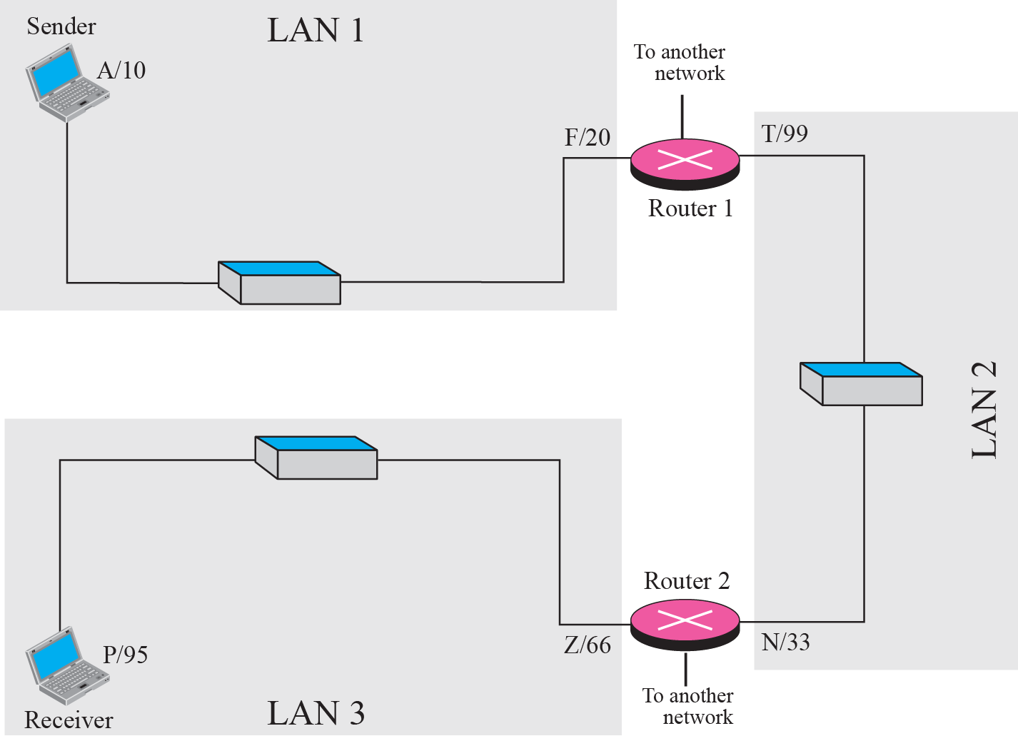
Example 2.5: logical addresses

Slide 14
The physical addresses will change from hop to hop, but the logical addresses remain the same.

Slide 15
Figure 2.18 shows two computers communicating via the Internet. The sending computer is running three processes at this time with port addresses a, b, and c. The receiving computer is running two processes at this time with port addresses j and k. Process a in the sending computer needs to communicate with process j in the receiving computer. Note that although both computers are using the same application, FTP, for example, the port addresses are different because one is a client program and the other is a server program, as we will see in Chapter 17.

Slide 16
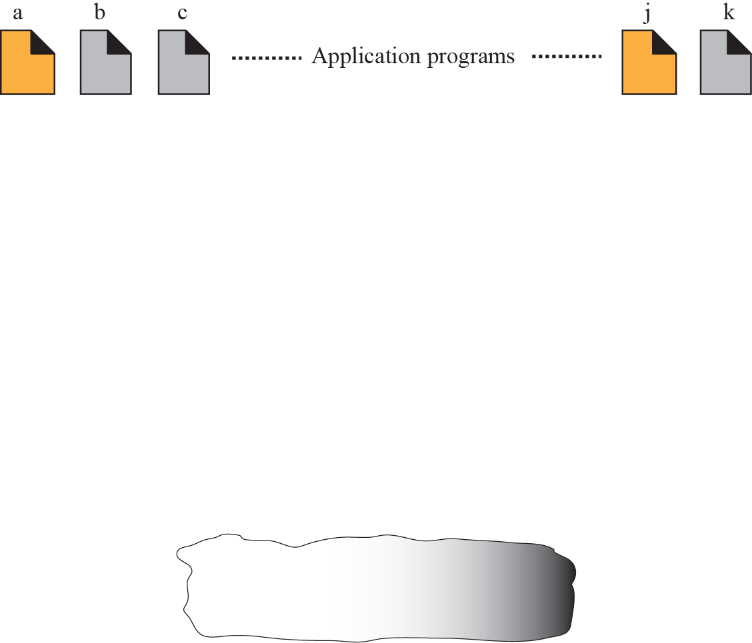
Example 2.6: port numbers

Slide 17
The physical addresses change from hop to hop, but the logical and port addresses usually remain the same.

Slide 18
As we will see in future chapters, a port address is a 16-bit address represented by one decimal number as shown.
753
A 16-bit port address represented as one single number

Slide 19
References
TCP / IP protocol Suite fourth edition Chapter 2 The OSI Model and the TCP / IP protocol Suite Behrouz A Farouzan

Slide 20
Thank You

